Slide 1

SPACESHIP TITANIC
Group Name: NHK
Wan Hoi Nam 23021285D
Fung Pui Kiu 23034284D
Lai Chun Ho 23020364D

Slide 2

TABLE OF CONTENTS
01.
02.
03.
Exploratory Data Analysis
Handle Missing Data
Feature Engineering
04.
05.
06.
Preprocessing
Model Analysis
Prediction
Investigate character and pattern of dataset
Fill the missing value of dataset
Transform raw data into feature
Change categorical data into numerical data
Find model to analyse
Predict the value

Slide 3

Introduction
Train data of spaceship titanic
Predict transported rate of passengers

Slide 4
01.
Exploratory Data Analysis

Slide 5
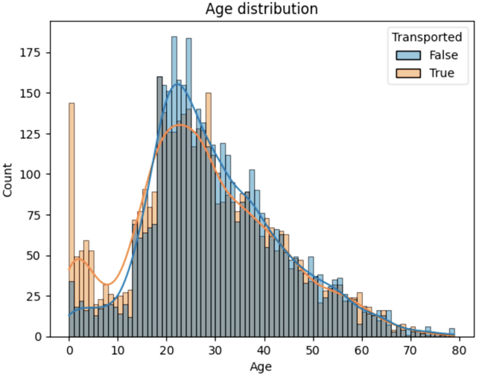

Age Distribution
Highest frequency Group: 20 – 29 years old $→$less likely transport
0 – 9 years old are more likely being transported
Over 29 years old is equal likely being transported
Insight:
Separated into Group (e.g. 0 – 9 years old, 10 -19 years old)

Slide 6
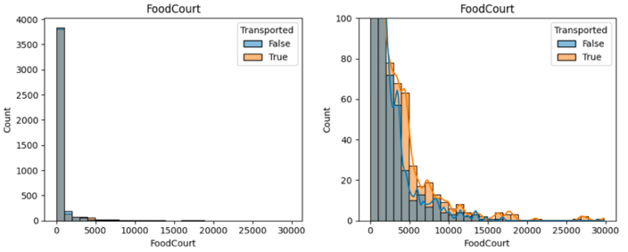
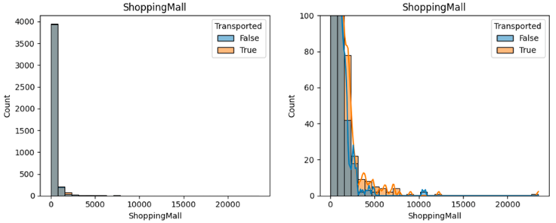
Expenditure
Food Court & Shopping Mall
Passengers who spend less money are less likely to be transported
Passenger who spends more money may likely to be transported.
Insight:
Most transported passengers spend less money while non-transported passengers not
Extract total expenditure on facilities

Slide 7
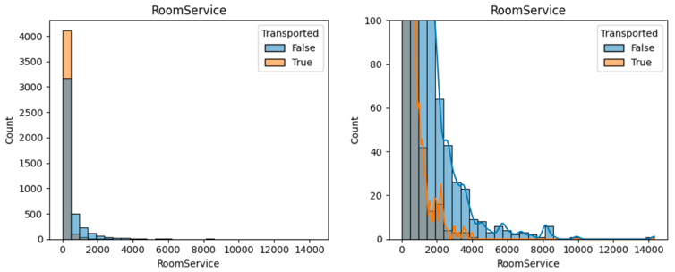
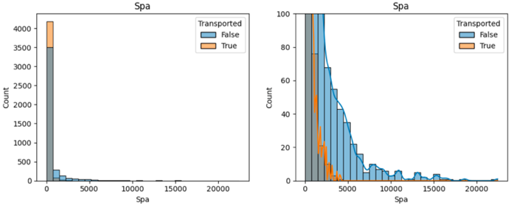
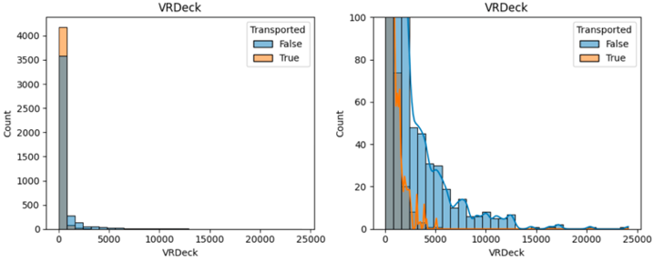
Expenditure
Room Service & Spa & VR Deck
Passengers who spend less money are likely to be transported
passengers who spend more money may not transported
Insight:
Most transported passengers spend less money while non-transported passengers not
Extract total expenditure on facilities

Slide 8
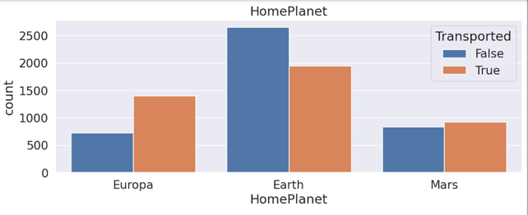
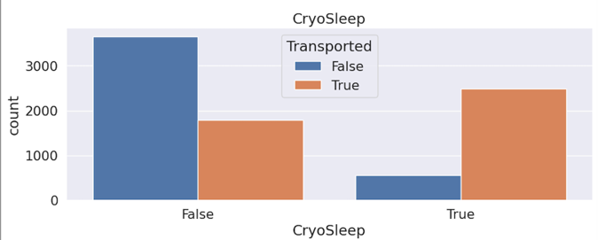
Categorical Feature
HomePlanet
CryoSleep
Passenger in Earth: less to be transported
Europa & Mars: likely to be transported
Have Cryosleep: more likely to transport
Haven’t Cryosleep: less likely to transport

Slide 9
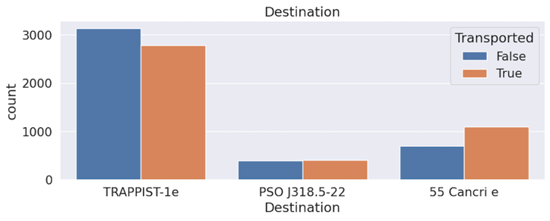
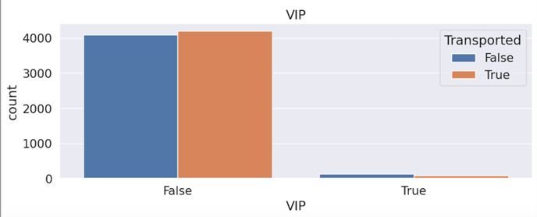
Categorical Feature
Destination
VIP
TRAPPIST - 1e: not to be transported
55 Cancri e: likely to be transported
PSO J318.522: equally transported
VIP: equally same transport rate
Rare to classify data with VIP

Slide 10

Insights on Categorical Feature
Cryosleep, Homeplanet, Destination : large contrast on transported rate
VIP: smaller contrast on transported rate
expected to delete this attribute

Slide 11
02
Handle Missing Data

Slide 12
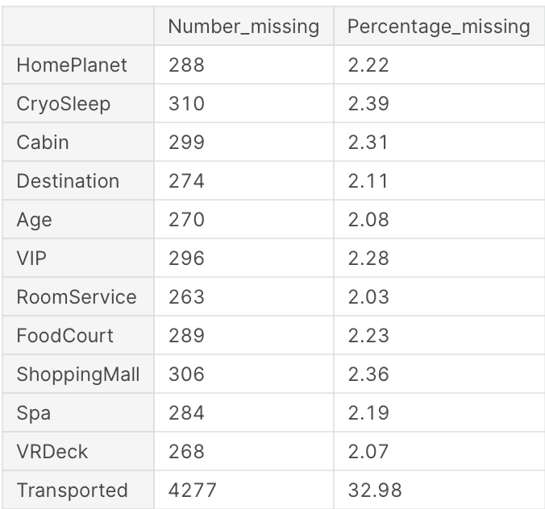
Handling missing data
Name, Cabin, PassengerId has dropped before because they are neither categorical data nor numerical data.
Insight:
Percentage of missing data in each column is less than 2.5% except the predicted column
Way to handle:
mode used to fill categorical attributes
median used to fill the numerical attributes

Slide 13
03
Feature Engineering

Slide 14
Assumption
01.
02.
Size of train set: 0.2
Method
The ratio of training set and testing set would be decided is 2:8.
The missing data would be filled before feature engineering.

Slide 15
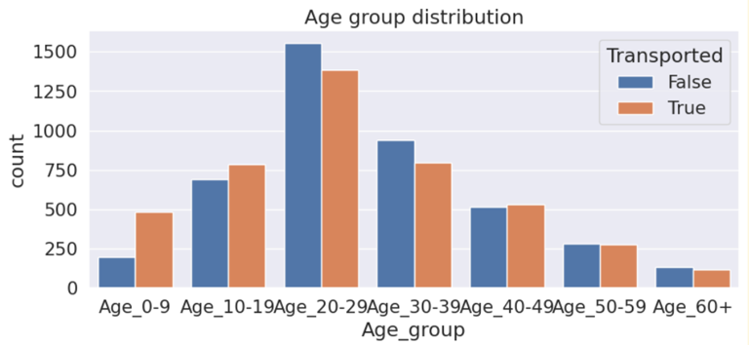
Age group distribution
Separated age group and tried to find out the relationship between the predicted value “transported” and the separated age groups.
Insight:
The ratio of transported in age group 0 – 9 is higher than rate of non – transported.

Slide 16
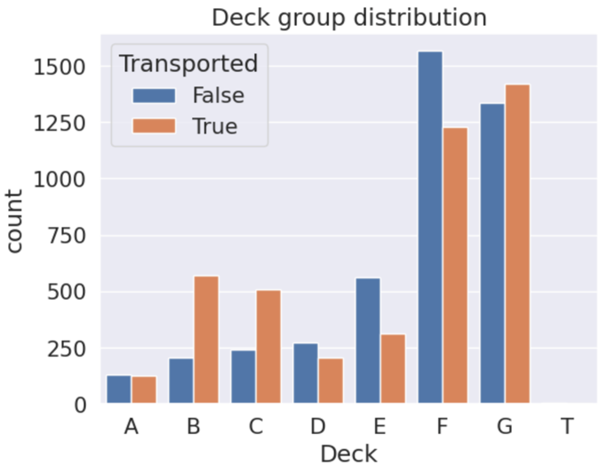
Deck group distribution
Extracted distribution of decks in spaceship individually.
Insight:
The deck of “T” might be an outlier because deck “T” has only 5 samples.

Slide 17
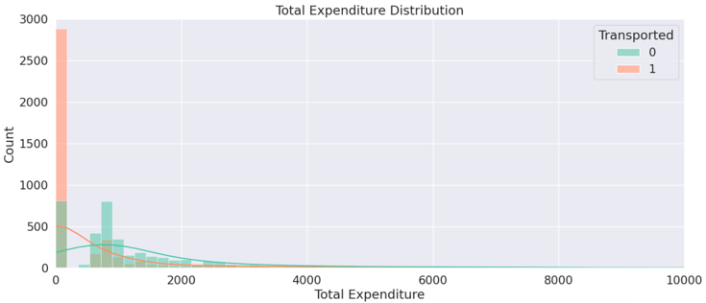
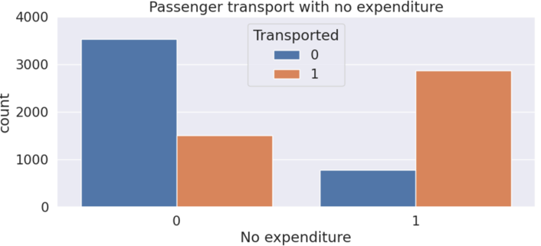
Total expenditure
Insight:
Passengers who do not spend money are transported successfully
Passengers who spend money has less potentially been transported
Refer to EDA, the total expenditure has included the expenditure of room service, food court, shopping mall, Spa, VR deck.

Slide 18
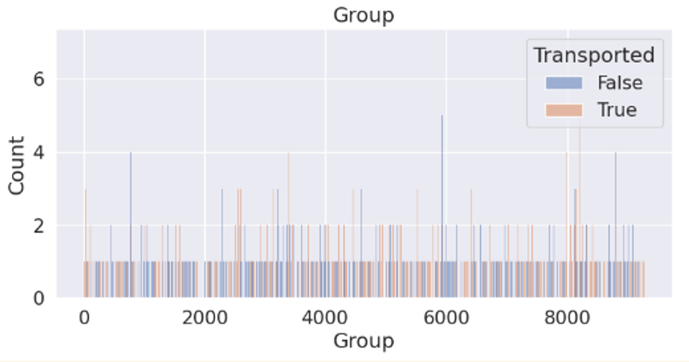
Group
Group has been calculated by the passagerId (gggg_pp)
Group size will be shown for each passenger
Insight:
Group would not use cause reflection of passenger group size. It might have duplicate records

Slide 19
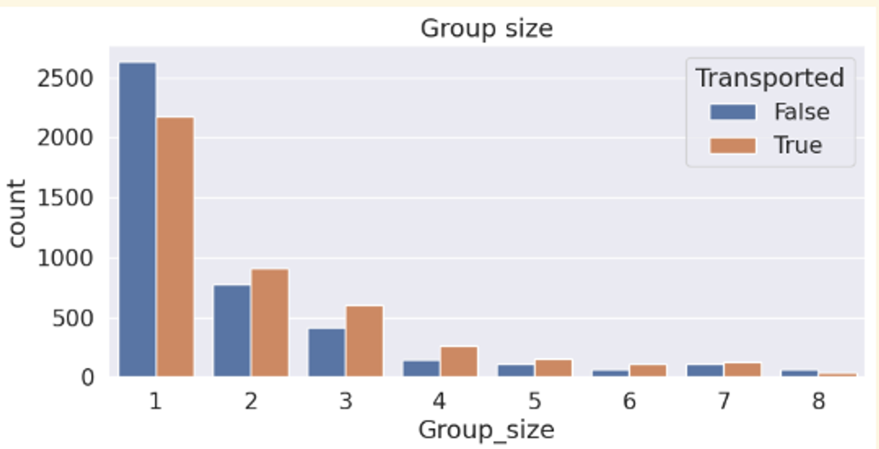
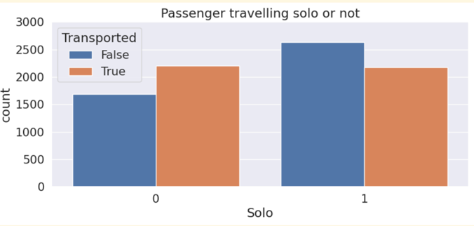
Group Size
Insight:
No. of passengers who travelling solo > No. of passengers who travelling non – solo
Value of transported solo is lower than value of transported non – solo
Insight:
Most passenger are travelling alone

Slide 20
04
Preprocessing

Slide 21
Preprocessing
Label Encoding Better
Homeplanet | Hp_label | Transported
Europa | 0 | Yes
Earth | 1 | No
Mars | 2 | Yes
Europa | 0 | No
Mars | 2 | Yes
Transported | Hp_europa | Hp_earth | Hp_mars
Yes | 0 | 1 | 0
No | 0 | 1 | 0
Yes | 0 | 0 | 1
No | 0 | 1 | 0
Yes | 1 | 0 | 0
Label Encoding
One – Hot Encoding
Provide a range value of 0 to (N - 1)
Reduce generated various feature
Separated into smaller feature
Provide a range value of 0(Yes) to 1(No)

Slide 22
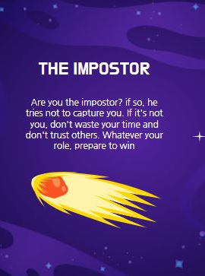
Validation Dataset
Estimate problem in train set
Adjust model analysis
Using testset affect accuracy of model analysis

Slide 23
05
Model Analysis

Slide 24
Confusion Matrix
Show model performance by using predicted value and actual value.
True label will present as y-axis and predicted label as the x-axis.
Four labels of model prediction will be displayed in matrix format, which are
true positives (TP),
false positives (FP),
true negatives (TN),
false negatives (FN).
 | Predicted label
True label | FN | FP
 | TN | TP

Slide 25
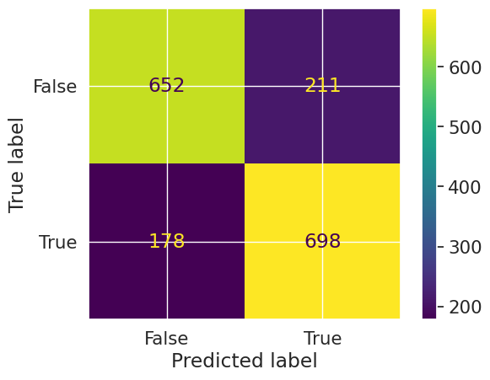
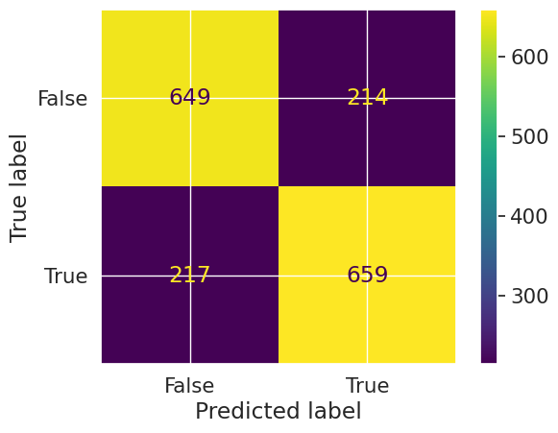
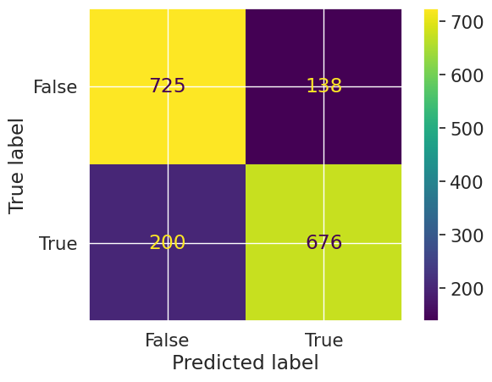
Confusion Matrix of different model
KNN
Decision Tree
Random Forest
Accuracy (0.776308)
Accuracy (0.752156)
Accuracy (0.805635)

Slide 26
06
Prediction

Slide 27

Question : If we handling feature engineering before handling missing data. Will there any change on the performance of prediction?

Slide 28
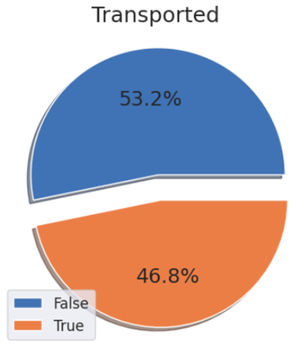
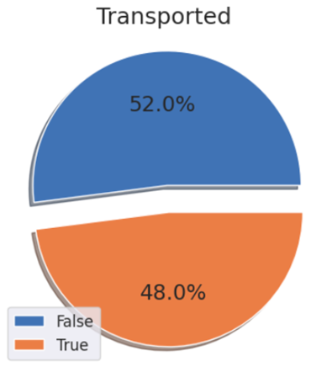
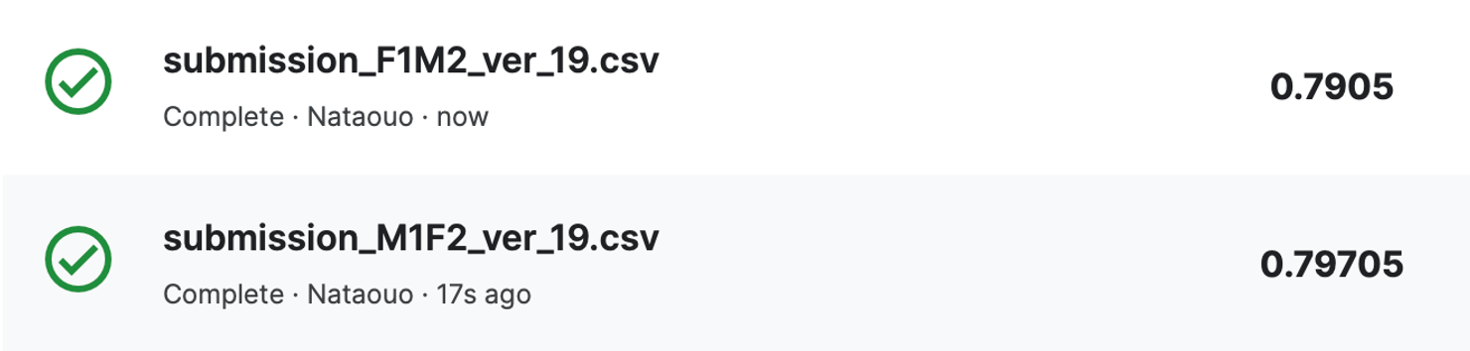

Troubleshooting
Version of handling feature engineering before handling missing data
Version of handling missing data before handling feature engineering

Slide 29
Findings:
The accuracy in handling missing data before feature engineering has a better performance (about 0.007%) then handling feature engineering before missing data.
The first method causes a negative impact on accuracy of dataset
Missing value will affect actual value of feature engineering

Slide 30
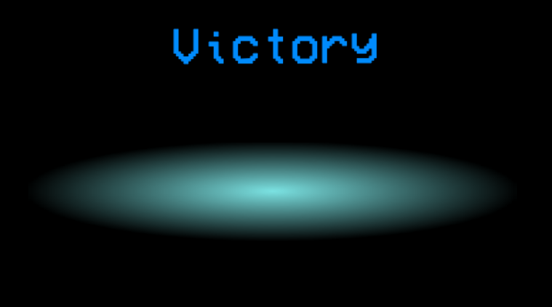

Slide 31
Link of Kaggle
Thanks for listening
https://www.kaggle.com/nataouo/space-nhk

